Slide 1

Case 1: Manufacturing Knowledge Hub
P&ID & Plot Plan Overview
Data Source
P&ID (Piping & Instrumentation Diagram) + Plot Plan
Purpose
Connect process logic, field location, operations, troubleshooting, and maintenance knowledge
Equipment & Flow
Piping & Valve Logic
Instrumentation & Control
Safety & Knowledge
Equipment list
Process flow paths
Material & utility movement
Pipes & connections
Valves & bypasses
Drains and vents
Sensors & transmitters
Control valves
DCS & monitoring points
Trips & alarms
Shutdown/interlocks
SOPs, incidents, live data
P&ID explains how the system works. Plot Plan shows where equipment is located.
Together they create operational context for decision-making.

Slide 2
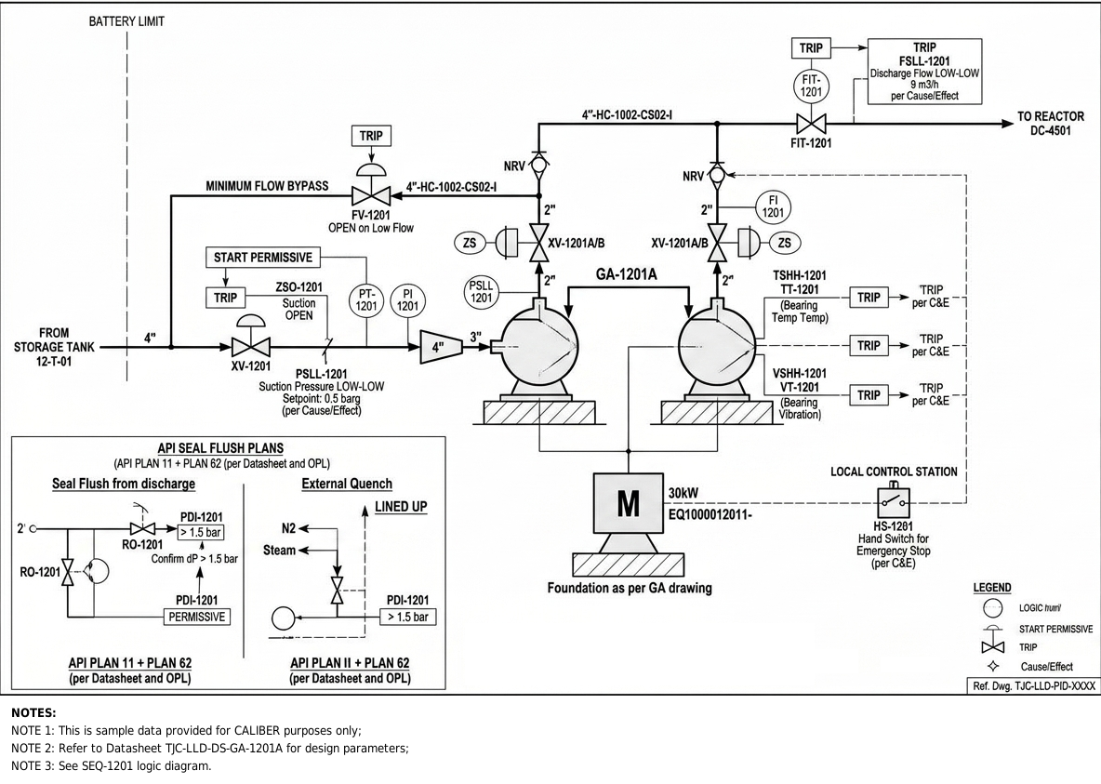
P&ID #SET 1 - Feed / Pumping System
What it shows
Feed transfer from storage tank to reactor/process
Pump protection logic: min-flow bypass, suction pressure, seal flush, vibration, temperature trips
What it Can be Extracted
What it can extract
Pump, valve, line, flow, pressure, motor tags
Trip, permissive, alarm and seal flush conditions
How it is useful
Explains start-up, low-flow and suction issues
Links logic with SOP and maintenance history

Slide 3
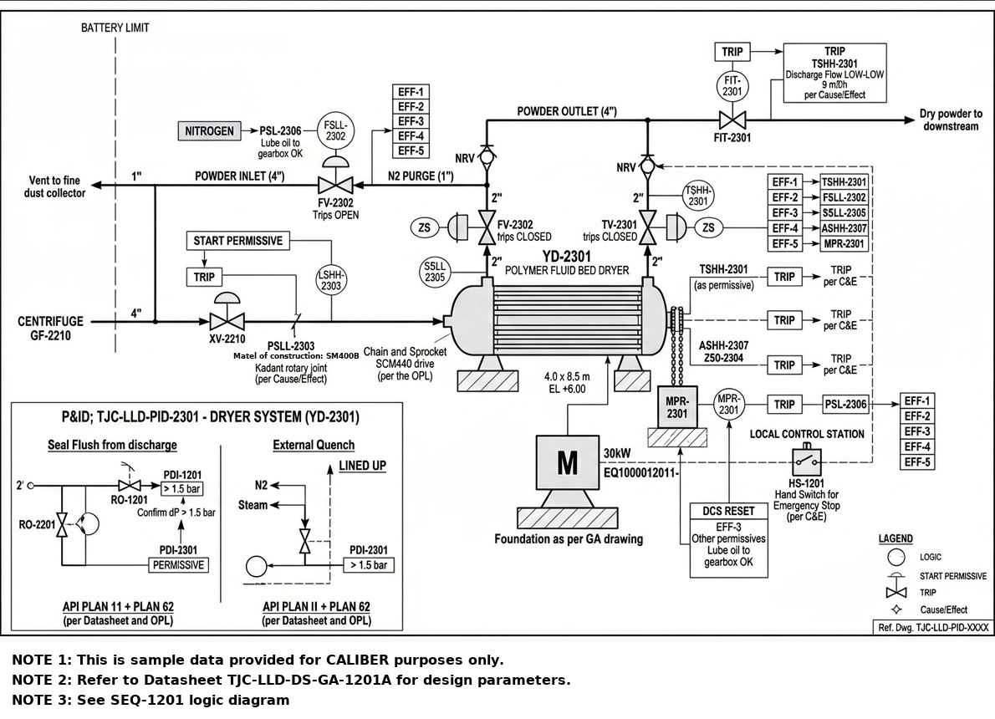
P&ID #SET 2 - Polymer Fluid Bed Dryer
What it shows
Dryer with powder inlet/outlet, N2 purge, venting and motor operation
Permissive and trip logic for flow, pressure, temperature, lube oil, vibration
What it can extract
Dryer, centrifuge, N2 purge, vent, motor and instrument tags
Start permissive, ESD, DCS reset and trip logic
How it is useful
Explains dryer trips and operating requirements
Connects SOPs, purge requirements and maintenance records

Slide 4
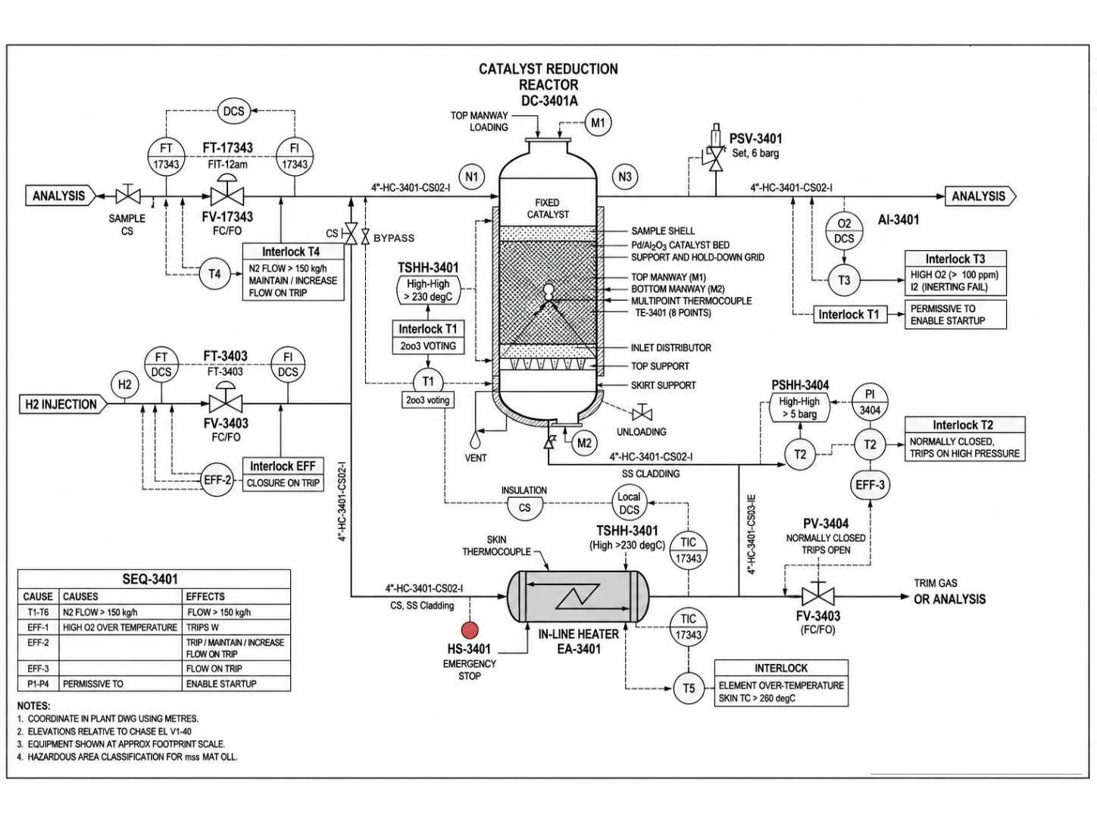
P&ID #SET 3 - Catalyst Reduction Reactor & Heater
What it shows
Hydrogen injection, catalyst bed, analysis point and temperature control
Safety-critical interlocks, permissives and high-temperature protection
What it can extract
Reactor, heater, analyzer, PSV, flow, temperature and interlock tags
Cause-and-effect logic and trip conditions
How it is useful
Answers safety-critical questions with references
Supports startup and temperature-interlock troubleshooting

Slide 5
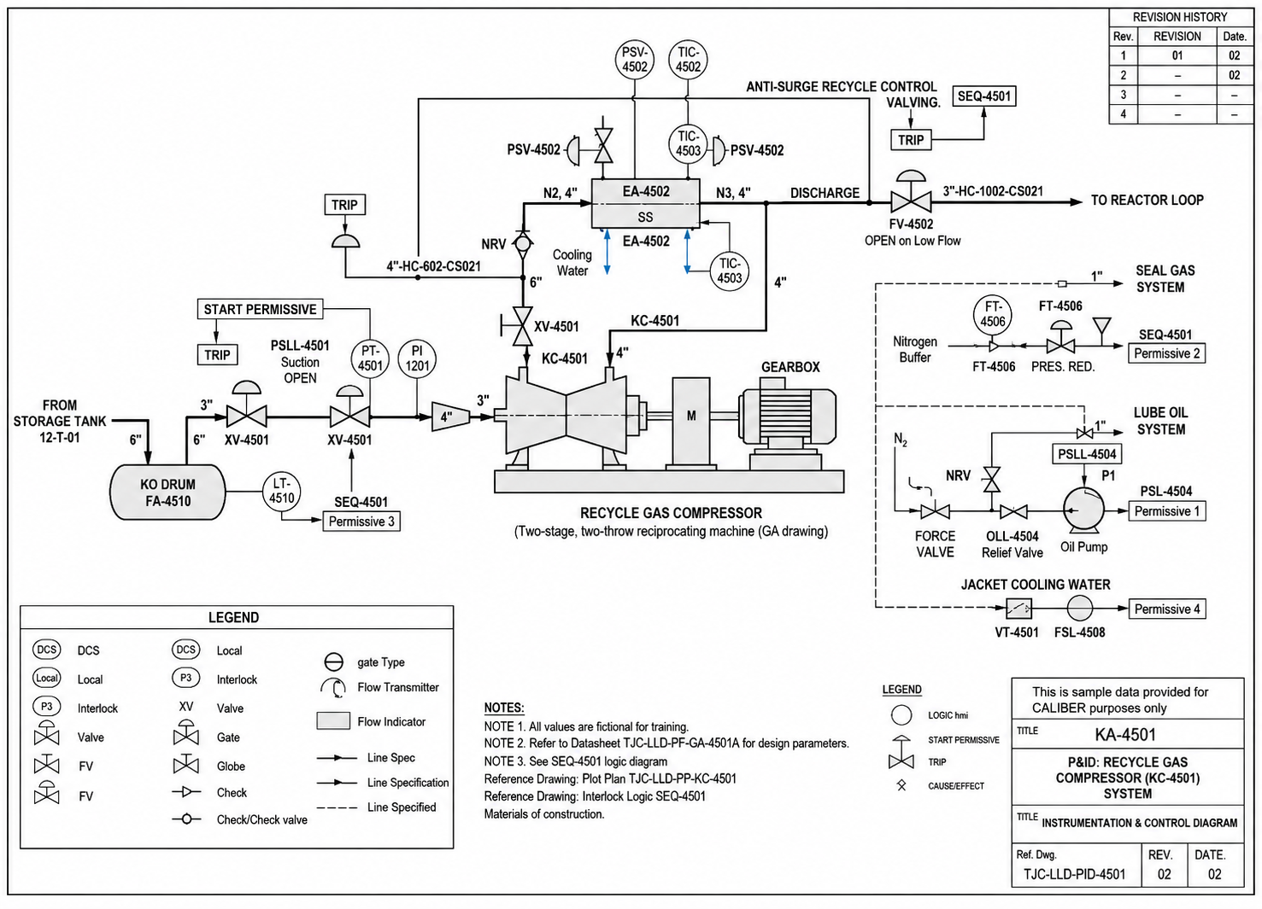
P&ID #SET 4 - Recycle Gas Compressor System
What it shows
Recycle compressor with anti-surge protection
Seal gas, lube oil and cooling-water support systems
What it can extract
Compressor, recycle valve, trip and permissive tags
Anti-surge logic and equipment protection data
How it is useful
AI helps Investigate compressor trips and root causes
Improve reliability and operational decision-making

Slide 6
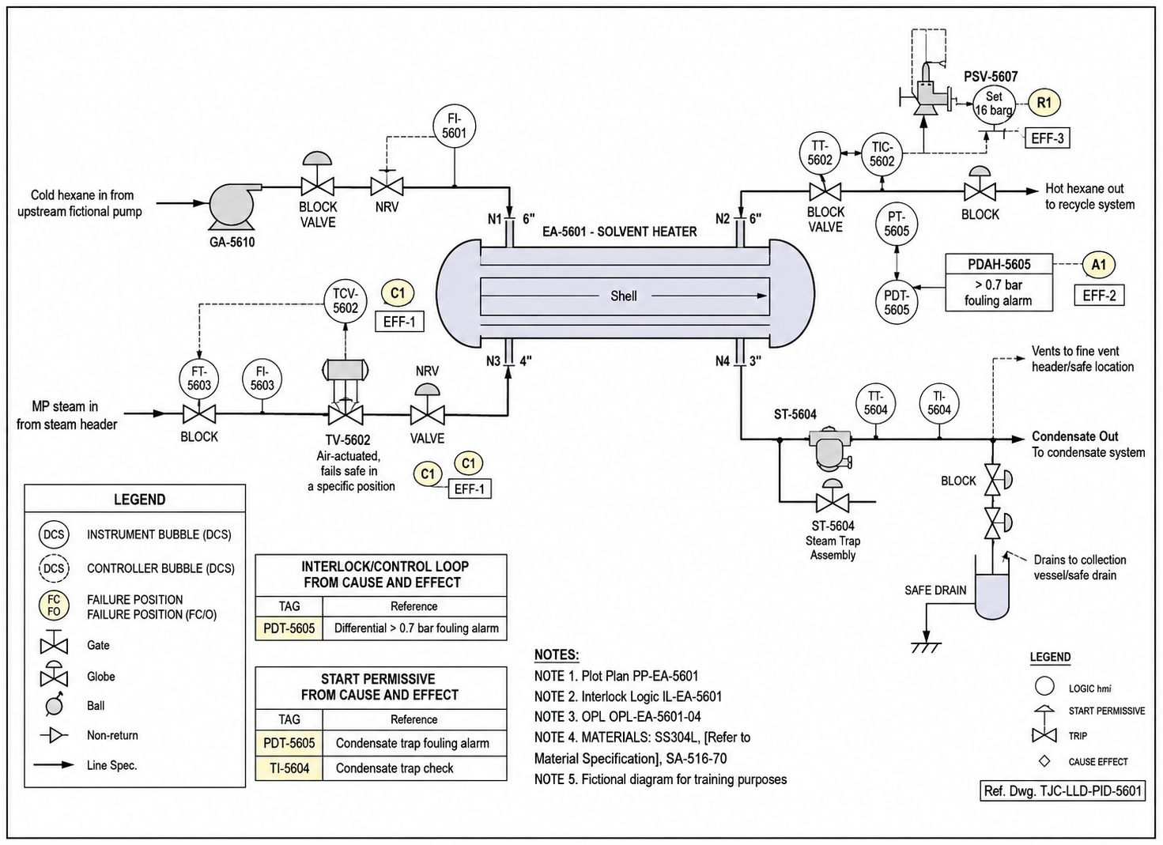
P&ID #SET 5 - Solvent Heater System
What it shows
Hexane heating using steam shell-and-tube heater
Temperature control, condensate and steam trap system
What it can extract
Heater, PSV, steam valve, trap and alarm tags
Fouling alarm and process protection information
How it is useful
Helps AI support heater performance troubleshooting and fouling analysis.
Support energy and maintenance optimization

Slide 7
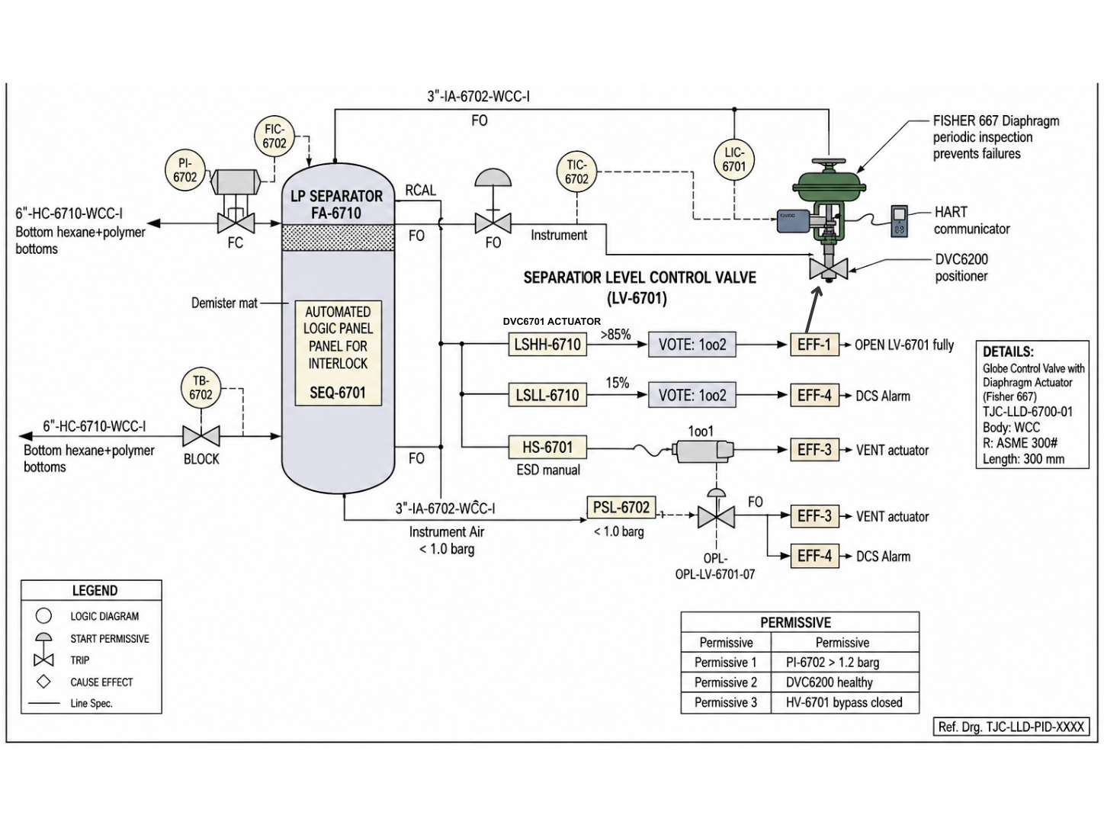
P&ID #SET 6 - Separation Level Control System
What it shows
LP Separator and level-control valve system
Instrument air, HART communication, and voting logic
What it can extract
Separator, LIC, LV-6701, DVC positioner tags
High/low level alarms, ESD actions, permissives
How it is useful
Diagnose level excursions and valve issues
Supports control valve troubleshooting, alarm interpretation, and safer operating decisions.

Slide 8
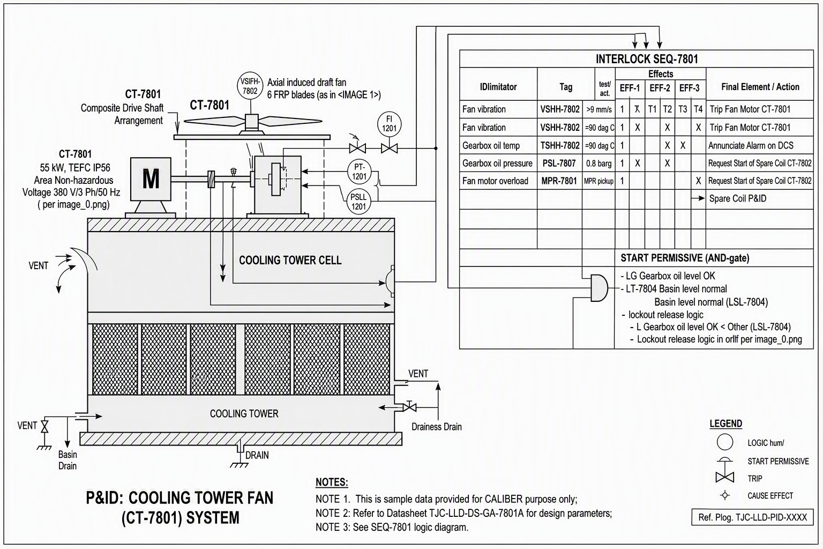
P&ID #SET 7 - Cooling Tower Fan (CT-7801) System
What it shows
Cooling tower fan, gearbox, motor and cooling cell operation
Interlocks related to vibration, oil temperature and motor load
What it can extract
Fan, gearbox, motor, vibration, temperature and permissive tags
Trip logic, spare-cell activation logic and DCS notifications
How it is useful
AI helps analyze fan trips and cooling-system reliability issues
Assist maintenance planning for vibration, gearbox problems, oil pressure verification, and motor overload investigation.

Slide 9
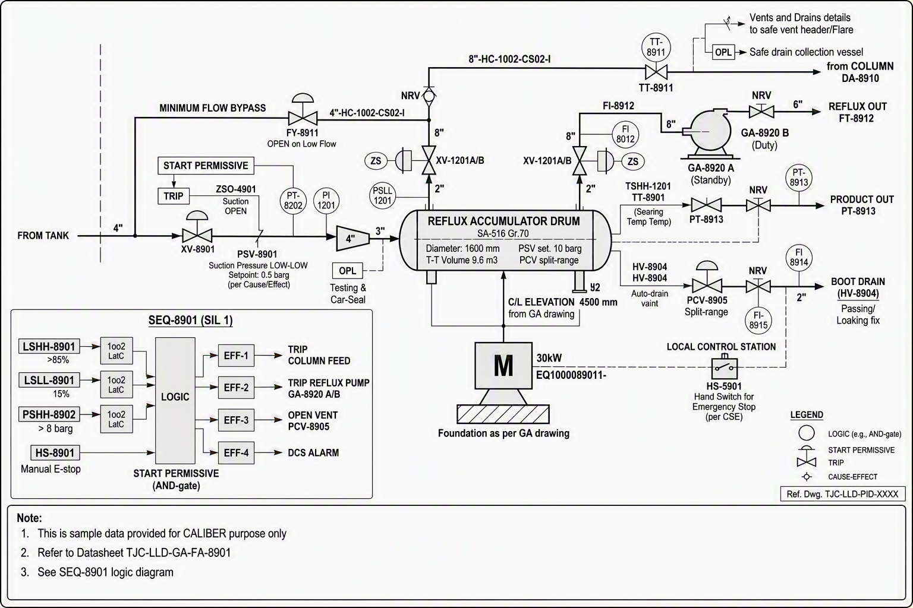
P&ID #SET 8 - Solvent Fractionation System
What it shows
Solvent fractionation and reflux accumulator drum system
Reflux pumps, level protection, venting and start permissive logic
What it can extract
Accumulator drum, pumps, valves, flow and pressure tags
SIL logic, high/low level alarms, trips and DCS alarm actions
How it is useful
Explain reflux operation and fractionation upsets
Support root-cause analysis for trips, alarms and level-control issues

Slide 10
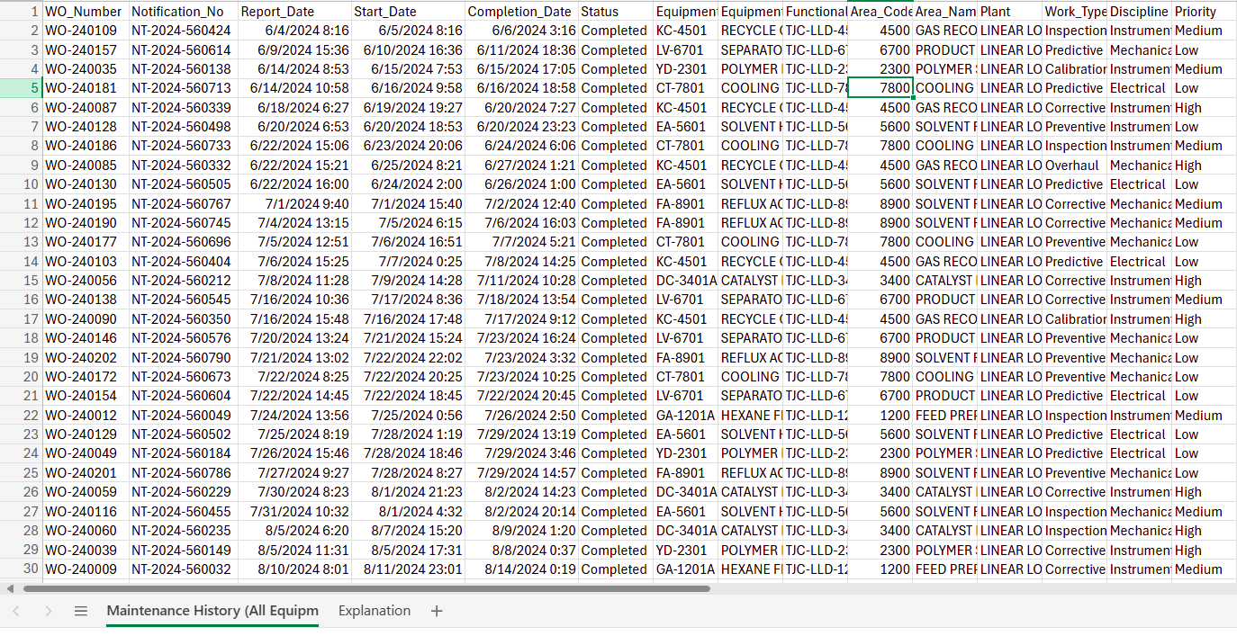
Maintenance History (Excel)
What it shows
Historical maintenance records for plant equipment
Failures, inspections, preventive, predictive, calibration, and overhaul activities
Downtime, maintenance costs, root causes, and corrective actions for each work order
What it can extract
Equipment reliability and failure trends
Recurring issues, root causes, and breakdown patterns
Downtime, maintenance cost, and spare part consumption analysis
Equipment-level maintenance history using Equipment Tag as the common key across datasets
Also please see the explanation of each column in this sheet
How it is useful
Identifies high-risk and high-cost equipment
Supports root cause and reliability analysis
Connects maintenance history with operational and engineering data
Enables predictive maintenance and maintenance knowledge hub use cases

